Slide 1
Agents and Multi-Agent Systems

Slide 2
Agent
An agent is an autonomous entity that perceives its environment through sensors and acts upon it using actuators to achieve certain goals.
An agent can be anything that can perceive and act, such as a robot, a software program, or a human being.

Slide 3
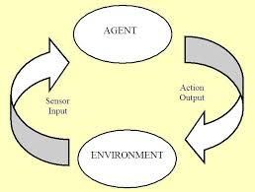
Agent

Slide 4
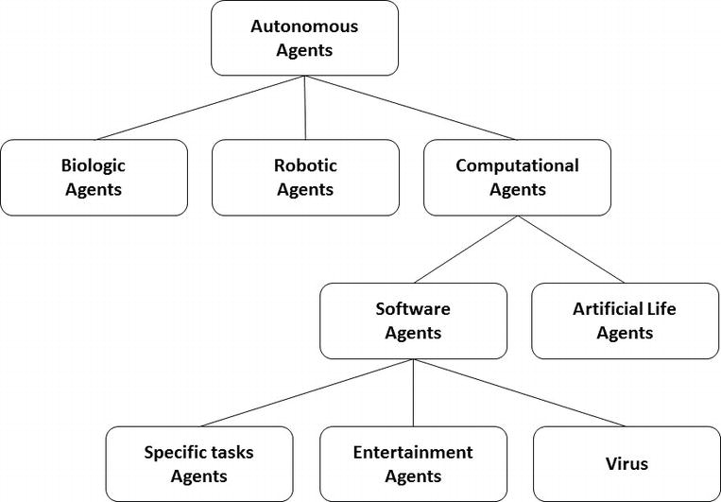
Agent

Slide 5
Key Characteristics of Agents:
Autonomy: Agents operate without direct human intervention.
Perception: Agents use sensors to observe their environment.
Action: Agents use actuators to affect their environment.
Goal-Oriented: Agents act to achieve specific goals or objectives.
Adaptivity: Agents can adapt their behavior based on their experiences and changes in the environment.

Slide 6
Multi-Agent System (MAS)
A multi-agent system consists of multiple interacting agents.
These agents may cooperate, compete, or have a combination of both.
MASs are used to model complex systems where multiple entities with their own goals interact within a shared environment.

Slide 7
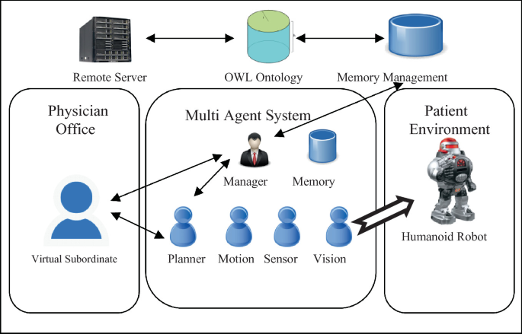
Multi-Agent System (MAS)

Slide 8
Key Characteristics of MAS:
Interaction: Agents interact with each other, which can be cooperative, competitive, or neutral.
Coordination: Agents may need to coordinate their actions to achieve common or conflicting goals.
Complexity: MASs can model complex scenarios where simple individual behaviors lead to emergent, complex behaviors.

Slide 9
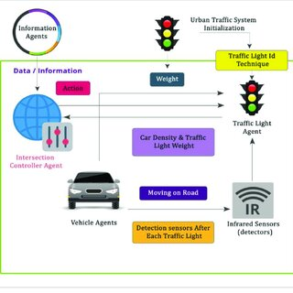

Slide 10
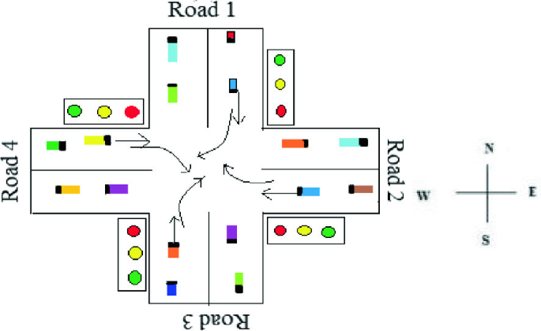

Slide 11
Agents in the System
Traffic Light Agents:
Perception: Traffic light agents use sensors to monitor vehicle counts, waiting times, and pedestrian signals at their respective intersections.
Action: Traffic light agents control the timing of red, green, and yellow lights based on their programmed rules or real-time data.
Goals: Each traffic light agent aims to optimize the flow of traffic at its intersection, reduce wait times, and ensure pedestrian safety.

Slide 12
Central Traffic Management System
Perception: This system collects data from all traffic light agents and road sensors.
Action: It adjusts the timing of traffic lights across multiple intersections to improve overall traffic flow in the city.
Goals: The central system aims to reduce city-wide congestion and optimize traffic flow through coordination of multiple traffic light agents.

